Slide 1
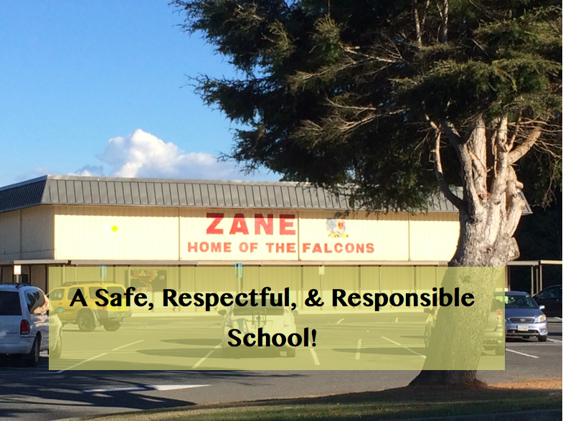
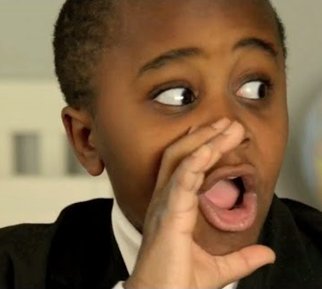
Did you miss
“20 Things...”?
Click here to catch up!
1

Slide 2
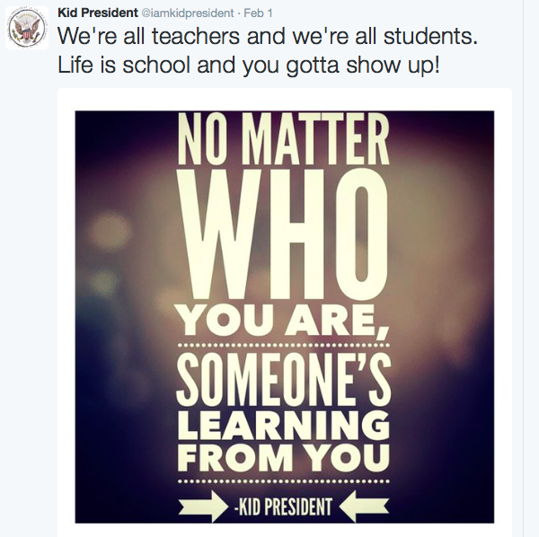
All the time and everywhere: Safe
Keep hands, feet and objects to yourself
Walk everywhere-especially to lunch and from gym and music -6th graders, THIS MEANS YOU!
Stay in designated areas (inside the red lines)
16

Slide 3
All the Time and Everywhere: Respectful
Leave other people’s things alone.
Clean up after yourself
Keep your voice level 0–2
18

Slide 4
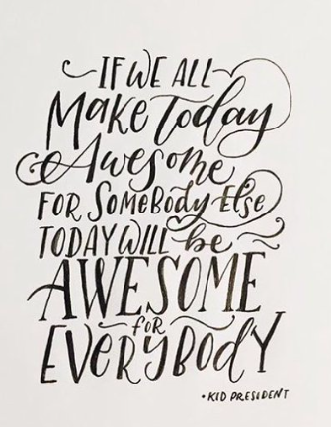
All the Time and Everywhere: Respectful
Use polite, school appropriate language at all times.
Be kind and tolerant to others, especially if they seem different from you.
18

Slide 5
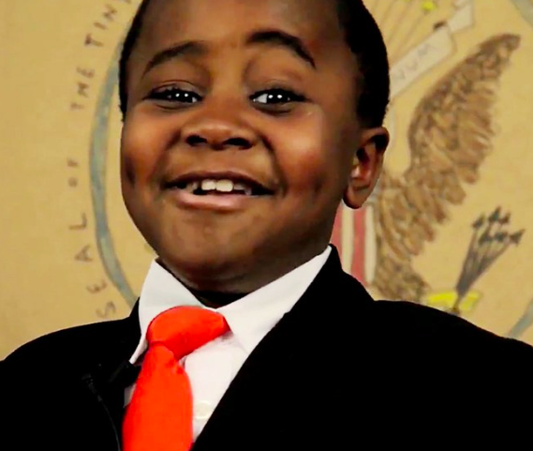
Zane Policy on Jammies and Blankies
Pajama bottoms and blankets are for home. Don’t wear them to school.
At school, dress a little nicer!

Slide 6
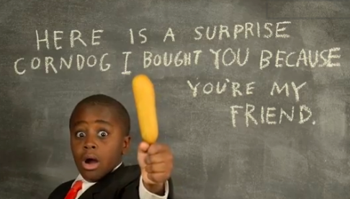
PBIS Cafeteria Update:
Good job on the voice levels.... 0-2
Throw away all your trash
Eat all cafeteria food in the cafeteria-sorry, no take out
Keep the SRR behavior going
WALK to lunch

Slide 7
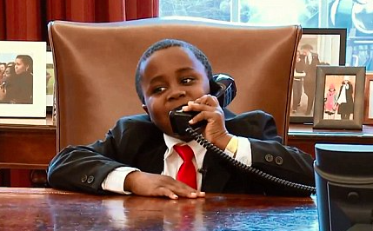
Be ON TIME
Ready to start BEFORE the bell!
Seated
Materials out
Quiz question: Will a student get marked “Tardy” even if they are in the classroom before the bell?
Y/N Discuss and explain.

Slide 8
Rainy Day Procedures
ON Rainy days, stay as dry as possible
Keep under the overhangs
Dry your feet when you enter a building
Stay cozy inside-if you love to play in the rain, save it for home!

Slide 9
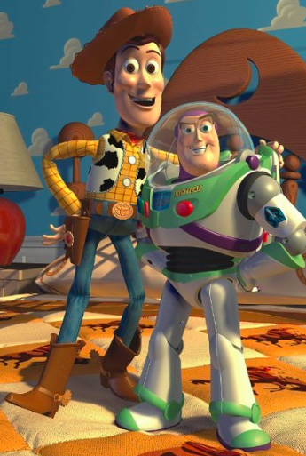
PDA
High fives- almost always OK, go for it!
Hugs: 3 second rule, stand a little apart
No Kissing-not at Zane, not even grandmas or babies! Don’t do it.

Slide 10
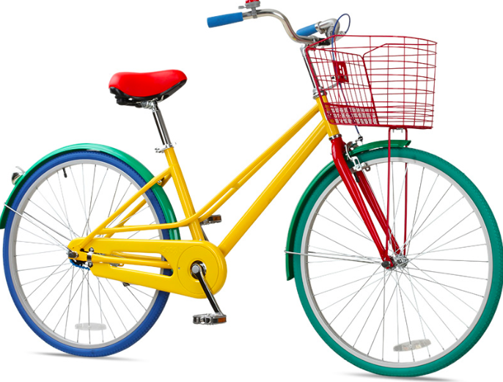
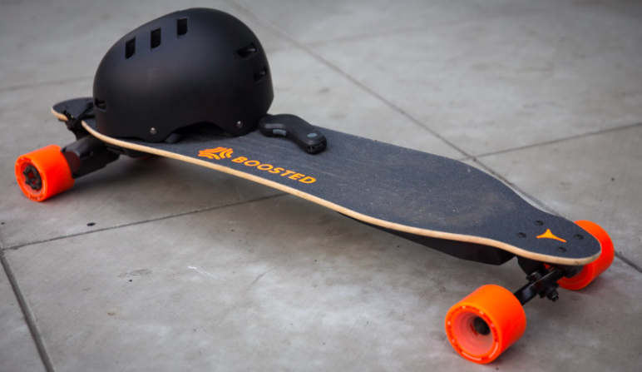
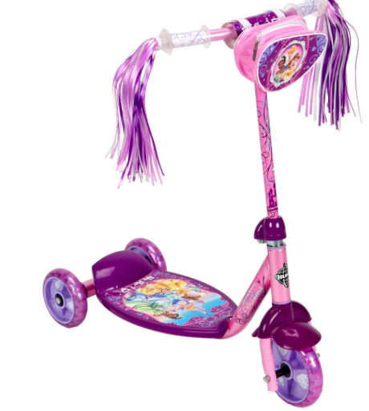
What to ride to school: Bikes, scooter, and skateboards: things that are safe and that you can lock up.

Slide 11
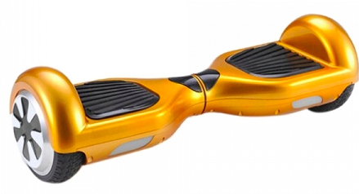
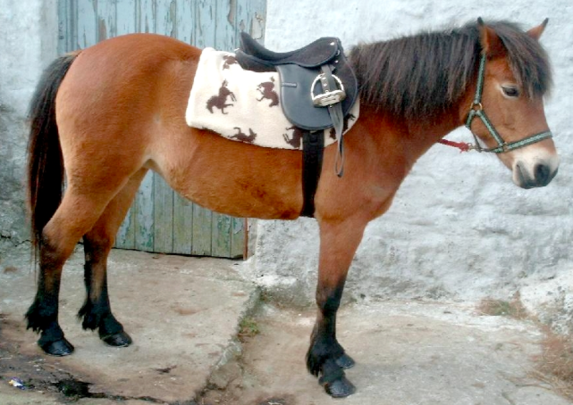
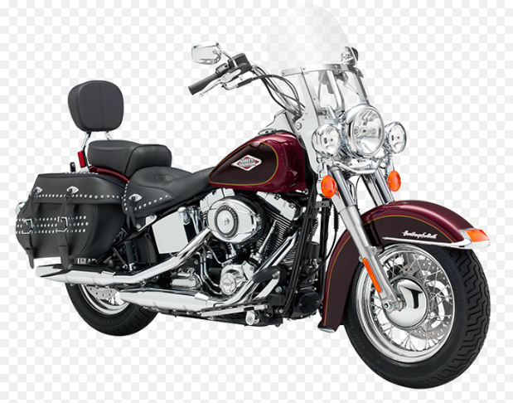
What NOT to ride to school:
‘Nuff said!

Slide 12
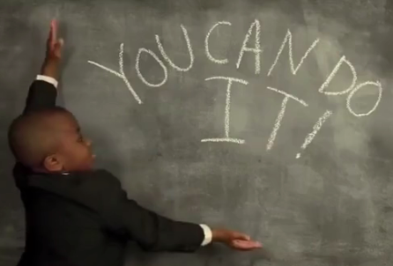
After School:
Remember to leave campus right away (by 3:15 )
Athletes are expected to go home after school.
After School students are to be in class by 3:15
Bus students are to wait calmly in line until the bus arrives (voice level 0-2)

Slide 13
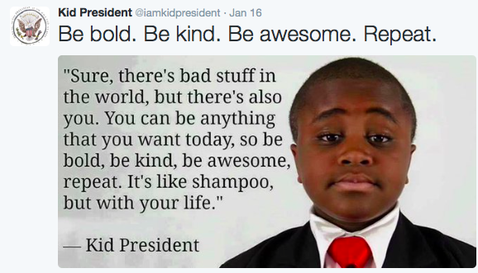
Now enjoy this 5 minute video

Slide 14
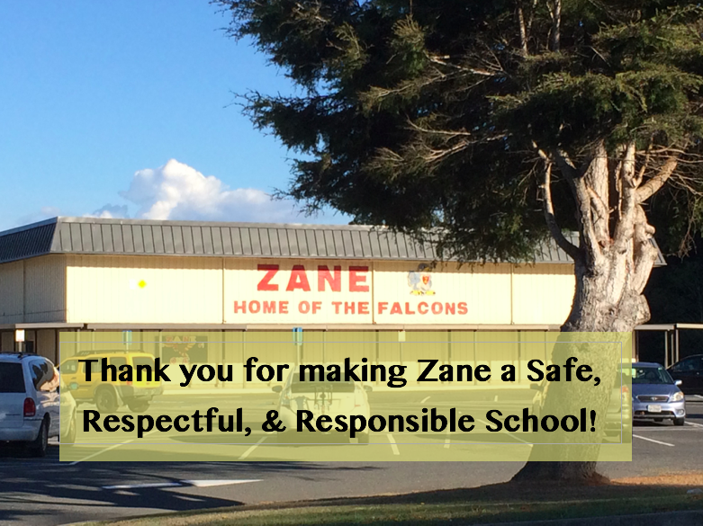
1

